Slide 1
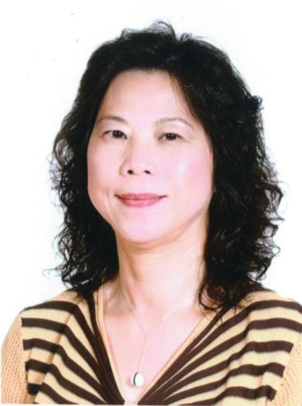
致勝零售策略
Fundamentals of Retailing
Lydia Wu
顧問經理級 Supervising Coordinator
四個佣金週期共賺取HK$57,500
HK$57,500 in 4 Commission weeks
本簡報中提到的收入等級純屬舉例說明，無意代表美安香港經銷商的一般收入，也無意表示任何經銷商皆可賺取同等收入。美安香港經銷商的成功與否，取決於其在發展事業時的努力、才能與投入程度。The income levels mentioned in the following presentation are for illustration purposes only. They are not intended to represent the income of a typical Market Hong Kong Distributor, nor are they intended to represent that any given Independent Distributor will earn income in that amount. The success of any Market Hong Kong Independent Distributor will depend upon the amount of hard work, talent, and dedication which he or she devotes to building his or her Market Hong Kong Business.

Slide 2
致勝零售策略 Fundamentals of Retailing

Slide 3
是愛的分享 is a sharing of Love
零售
Retailing
分享
Sharing
就是美德！
is a virtue!

Slide 4
Key of Retailing
了解產品，增加知識 自己先成為產品中的產品
自己先轉移消費習慣分享到親身體驗
分享 透過自己和別人的見證
工具必備
零售成功的關鍵
Obtain knowledge about your product Be a Product of the Product
Convert your consumption habit Tell Your Story
Sharing Your and others’ testimonials
Necessary tools

Slide 5
®
™

Slide 6
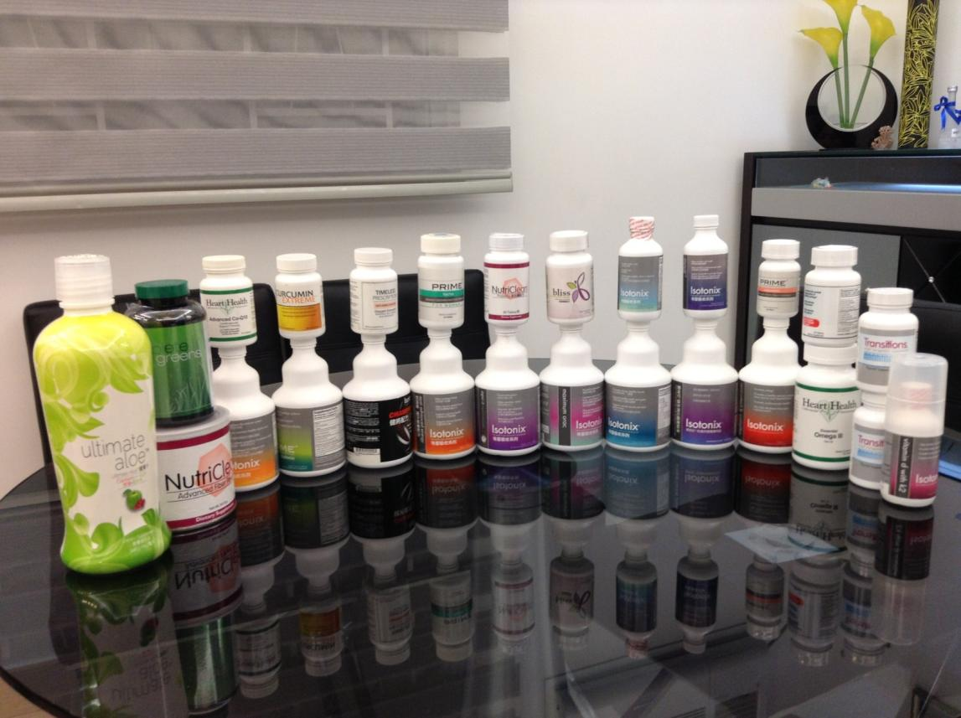
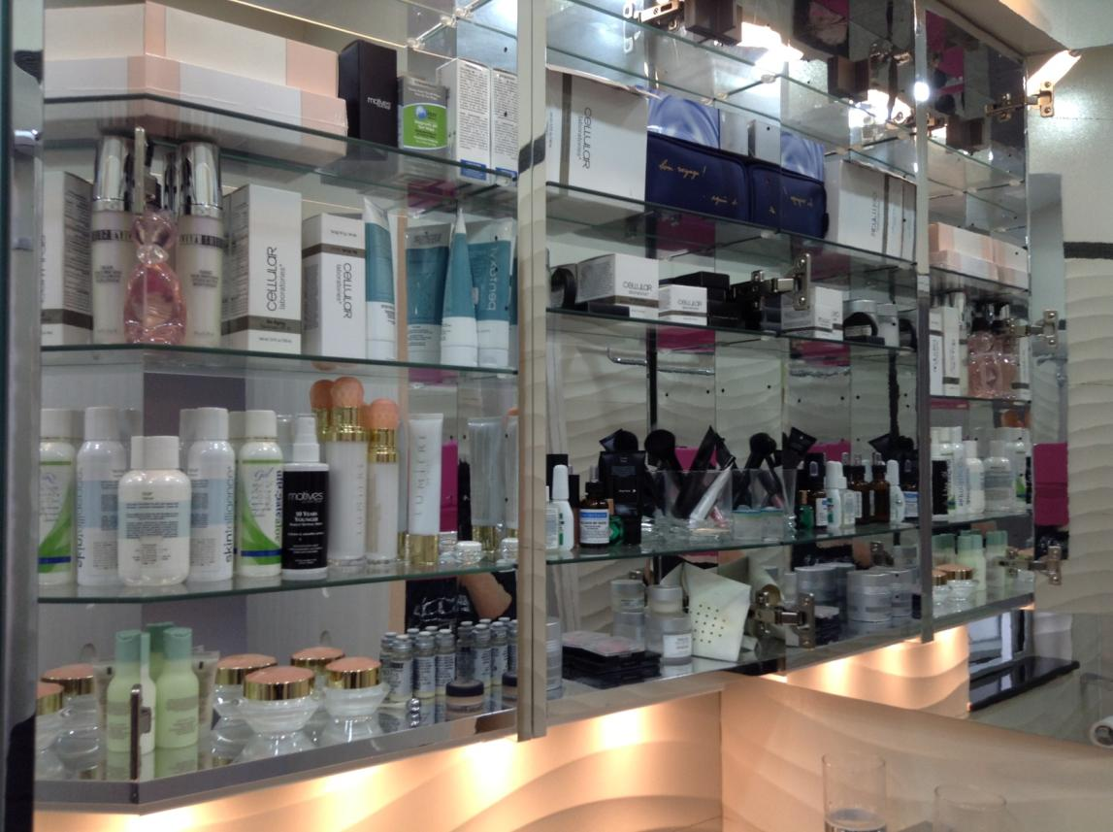
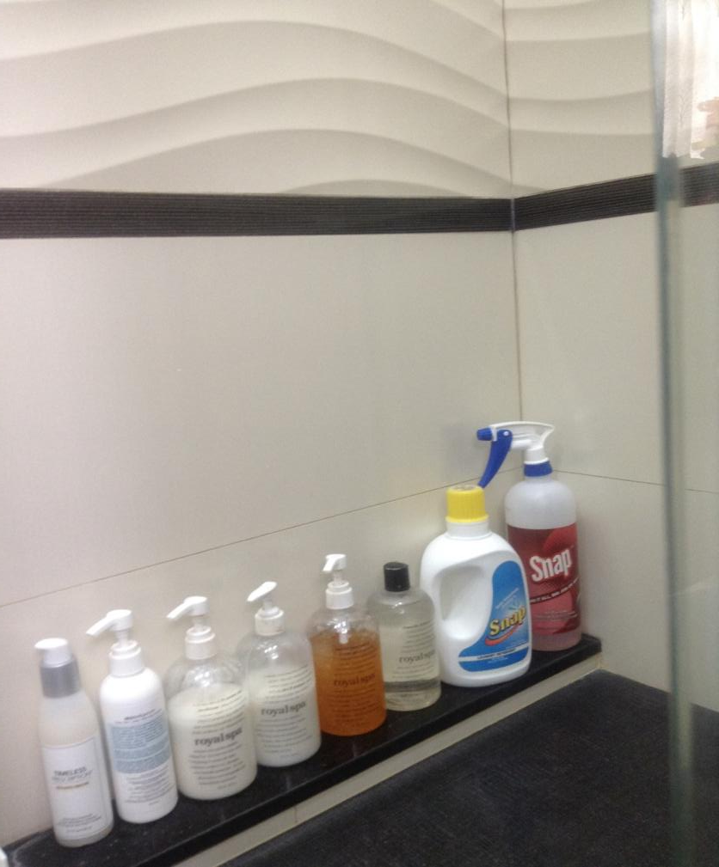

Slide 7
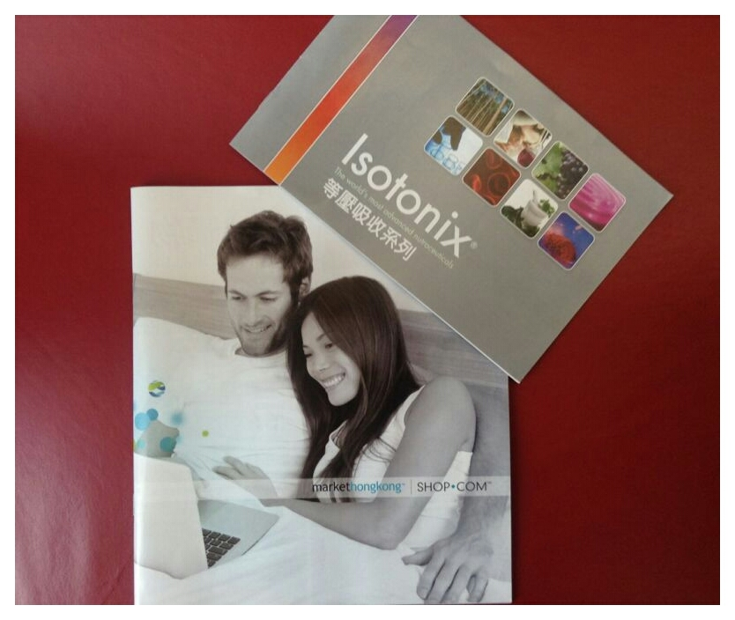

Slide 8
零售前
建立關係
用心傾聽
耐心講別人的故事（見證）
誠心誠意介紹美安產品
Before retailing
Build relationship
Listening carefully
Tell Your Story (Testimonials)
Sincerely introduce mhk products

Slide 9
零售應用過程
ABC法則
貼心的服務態度
關愛的跟進
從而增加顧客的購物種類
Application of Retailing
ABC pattern
VIP service attitude
Caring follow-up
To build Share of Customers

Slide 10
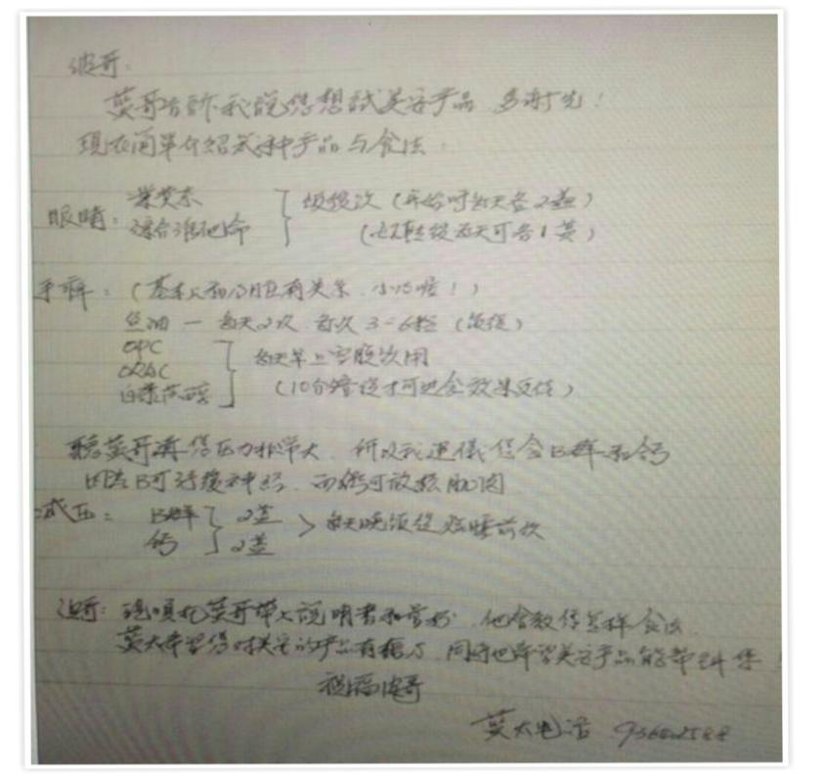
愛心、關心、耐心的跟進
Follow-up with love, care and patient

Slide 11
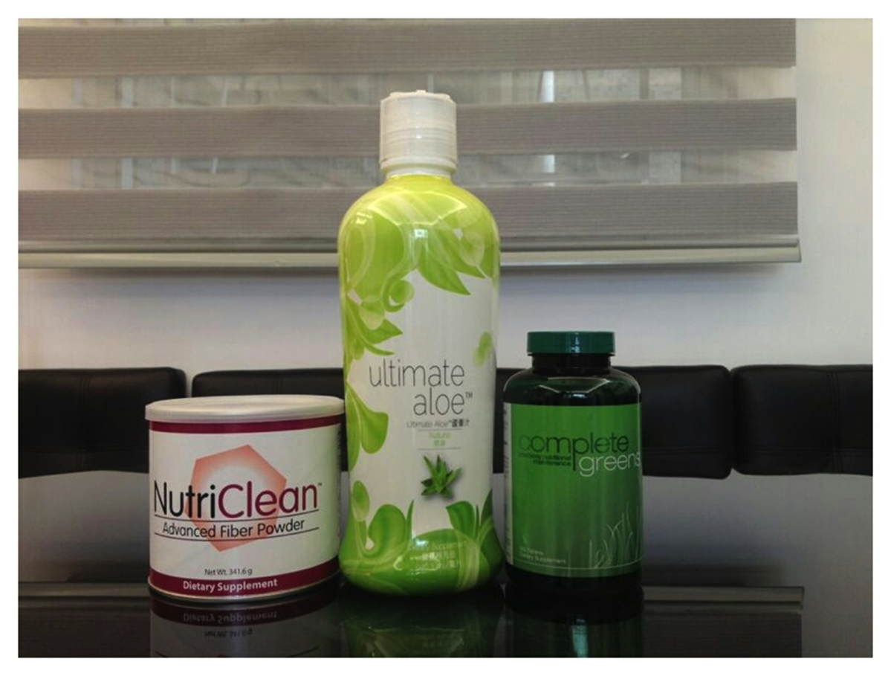
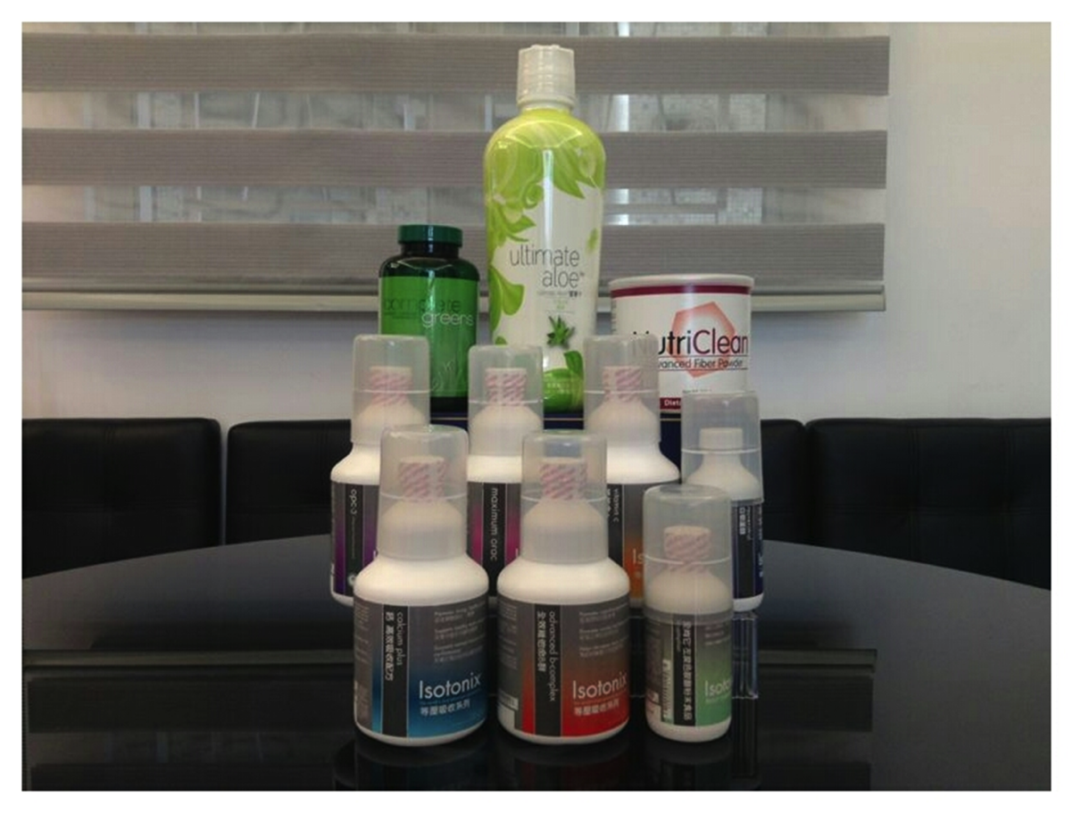
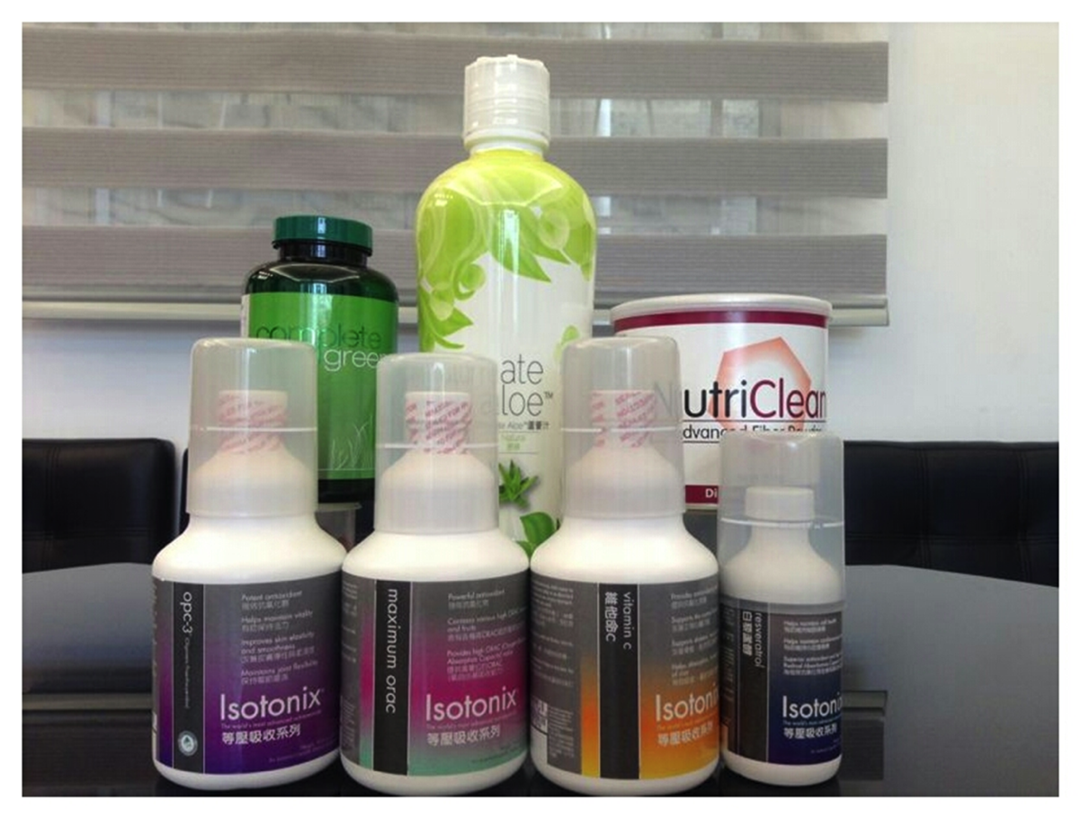

Slide 12
零售成功的成果
建立十位忠誠顧客
建立了顧客後面的顧客群
Result of successful retailing
Build 10 loyal customers
Build customers behind these customers

Slide 13
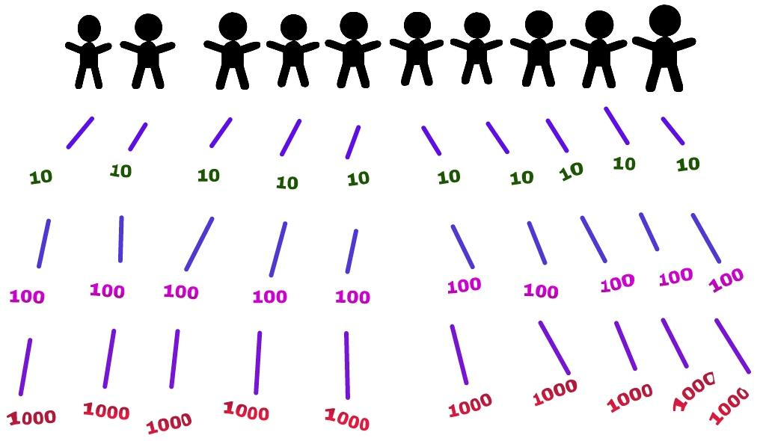
零售成功的結果
Result of successful retailing

Slide 14
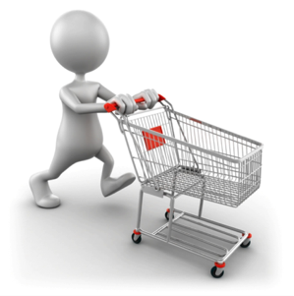
透過零售建立你的事業
利潤
賺回創業成本
抵付每月經常開銷
創造源源不斷的業績點數
發掘潛在的事業人選
建立信心
業績點數/獎勵業績點數 = 每週收入
Retail builds your business
Profit
Replace start-up expense
Cover monthly overhead expense
Generate ongoing BV
Identify potential prospects
Build confidence
BV/IBV = Weekly Income

Slide 15
嶄新的公司，嶄新的機會，嶄新的你
2014美安香港年會
mhk Annual Convention
#MHKAC2014

Slide 16
致勝零售策略 Fundamentals of Retailing

Slide 17
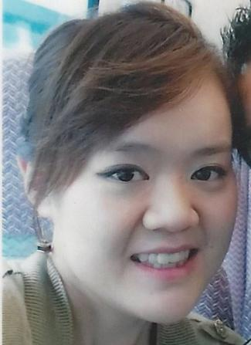
致勝零售策略
Fundamentals of Retailing
Ruth Ng
資深主管經理級 Senior Master Coordinator
四個佣金週期共賺取HK$23,000
HK$23,000 in 4 Commission weeks
本簡報中提到的收入等級純屬舉例說明，無意代表美安香港經銷商的一般收入，也無意表示任何經銷商皆可賺取同等收入。美安香港經銷商的成功與否，取決於其在發展事業時的努力、才能與投入程度。The income levels mentioned in the following presentation are for illustration purposes only. They are not intended to represent the income of a typical Market Hong Kong Distributor, nor are they intended to represent that any given Independent Distributor will earn income in that amount. The success of any Market Hong Kong Independent Distributor will depend upon the amount of hard work, talent, and dedication which he or she devotes to building his or her Market Hong Kong Business.

Slide 18
Personal Profile
自我介紹
英屬哥倫比亞大學畢業 （主修營養科學學系）
整體營養師
註冊生物共振療法治療師（瑞典）
保健品顧問 (for HK IVF Specialist)
高級臨床技師 （高階運動學測試）
初級註冊血液分析師
University of British Columbia (Nutritional Science)
Holistic Nutritionist
Registered Bioresonace Therapist (Sweden)
Nutraceutical Consultant (for HK IVF Specialist)
Senior Clinical Technologist (Advanced Kinesiology Testing)
Junior Certified Live Blood Analyst

Slide 19
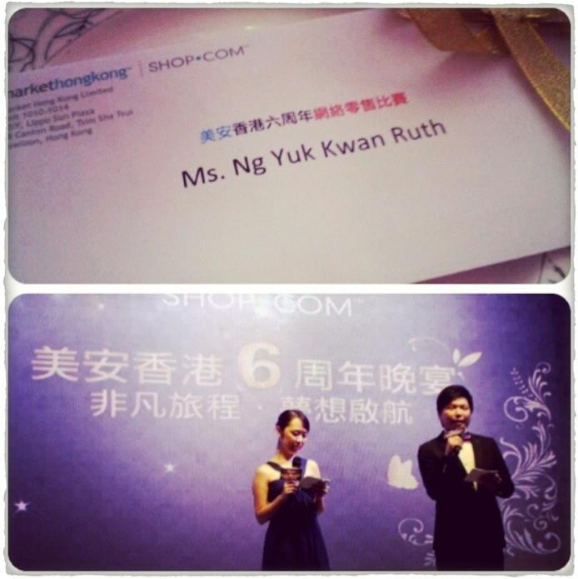
網路零售
Online Retailing

Slide 20
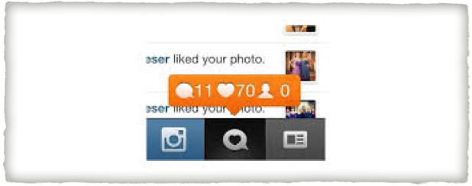
是怎樣開始的？ How Did It Started?
每個人都喜歡分享Everyone likes to share

Slide 21
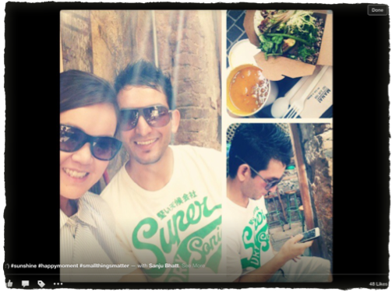
分享 Sharing
135 likes:) 讚好
48 likes 讚好!

Slide 22
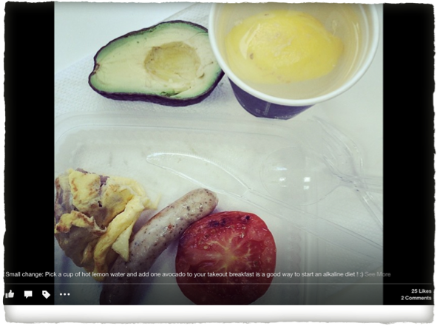
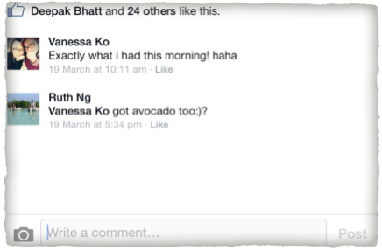
自由配搭 Mix and Match
常見的日常話題
經常性的
保持你個人風格和特色
Common daily topic
Common
Keep your own style and character

Slide 23
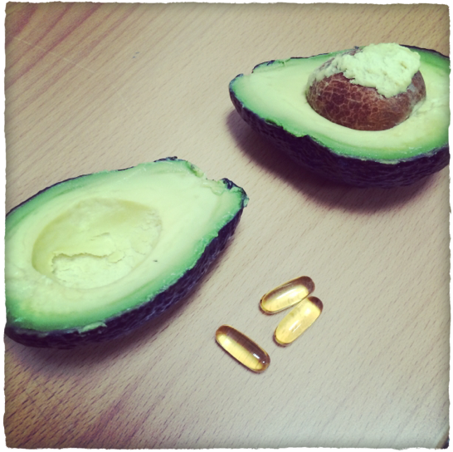
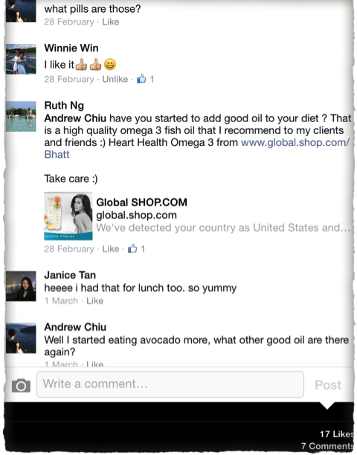
引起興趣！
Get people interested!
xxxxx

Slide 24
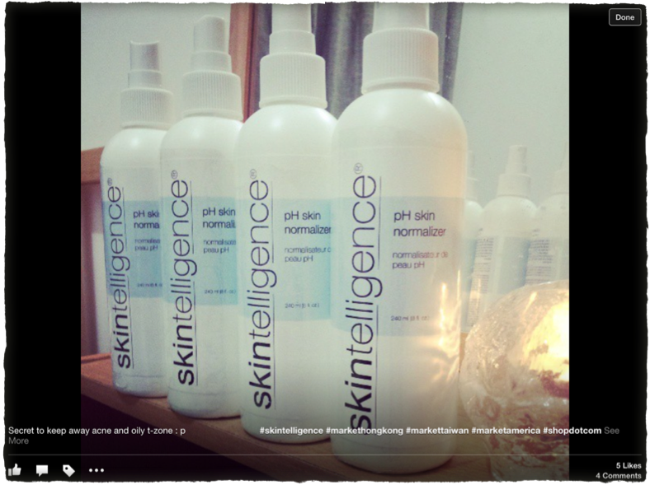
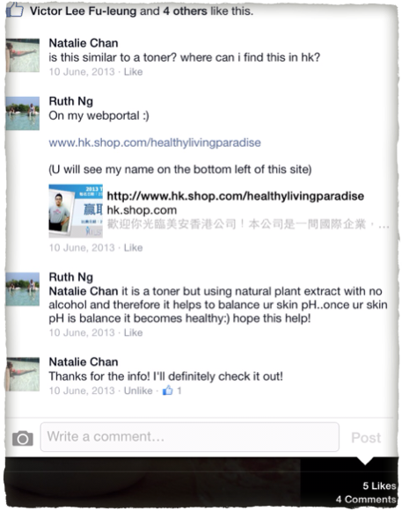
xxxxx
xxxxx

Slide 25
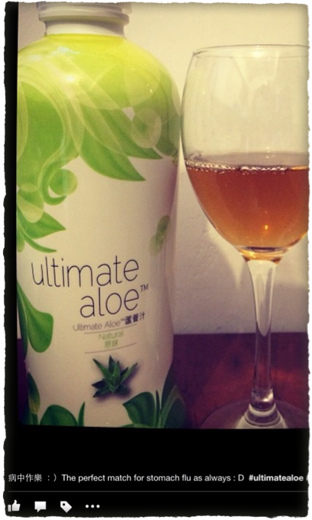
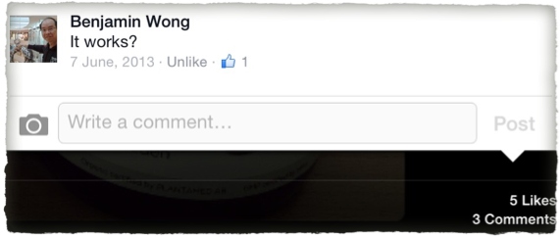
提出問題
Asking Questions

Slide 26
零售
Retailing
零售 = 重覆說話內容
重覆在Facebook和Instagram刊登的內容
重點是做回你自己
分享你個人經驗
將心比己
最重要是自己先做產品的代言人
Retailing = Re-telling
Re-telling on Facebook and Instagram
Key is to be yourself
Share your experience
Put yourself in your audiences’ shoes
Most important is to “be a product of the product”

Slide 27
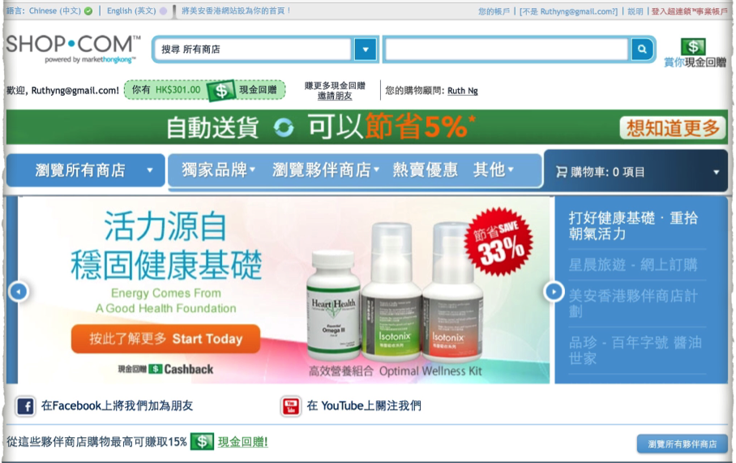
分享你的購物習慣 Share your shopping habit

Slide 28
經常與人分享快樂和正面的訊息
永遠向前進 ☺
Always share happy and positive things
Pay it forward ☺
默默地努力
讓成功換來掌聲

Slide 29
嶄新的公司，嶄新的機會，嶄新的你
2014美安香港年會
mhk Annual Convention
#MHKAC2014

